Slide 1
CARBOHYDRATES
STRUCTURE:
C, H, O in 1:2:1 ratio
Monomer – monosaccharide
Simple carbs → sugars (mono & disaccharides)
Complex carbs → polysaccharides

Slide 2
FUNCTIONS:
Energy → between C-H bonds
Cell fuel – sugars (glucose)
Stored E – starch, glycogen
Structural
Cellulose (plant cell walls)
Chitin (exoskeletons)
Cell Identification
blood types (glycoproteins)

Slide 3
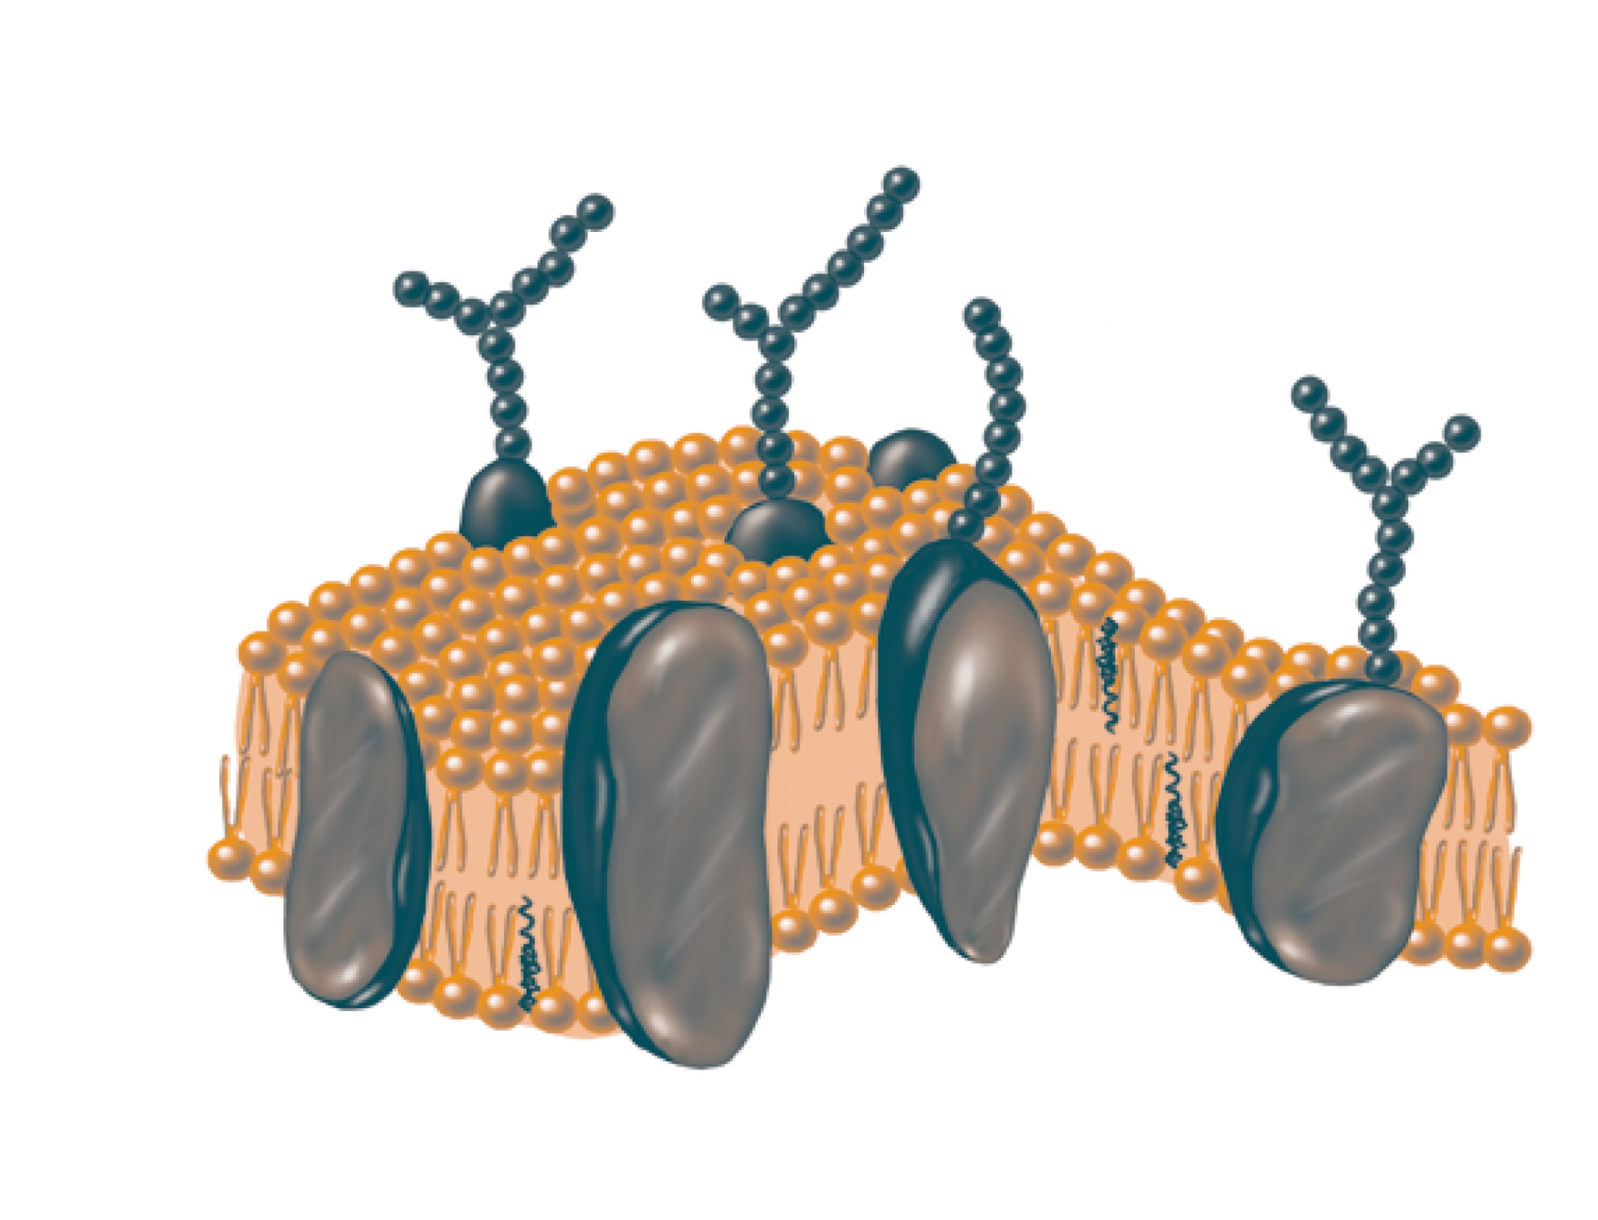

Slide 4
LIPIDS
STRUCTURE:
C, H, O - many more C & H
Monomer – fatty acid
Fatty acids connect to other molecules (like glycerol) to form triglyceride (just 1 example)

Slide 5
FUNCTIONS:
Energy Storage
More C-H bonds than carbs
Cell Membranes
“skin” of EVERY CELL!
Steroids
Chemical messengers (testosterone, estrogen)

Slide 7
PROTEIN
STRUCTURE:
C, H, O, N (sometimes Sulfer)
Monomer – amino acid
Amino acids link together via PEPTIDE bonds to form a polypeptide chain
This chain folds up to form a functional protein

Slide 8
STRUCTURE (cont.):
Each A.A. has different properties (polarity, charge, etc)
These properties cause them to fold is specific ways
3-D shape is ESSENTIAL to proper protein function
Wrong shape and protein won’t function

Slide 9
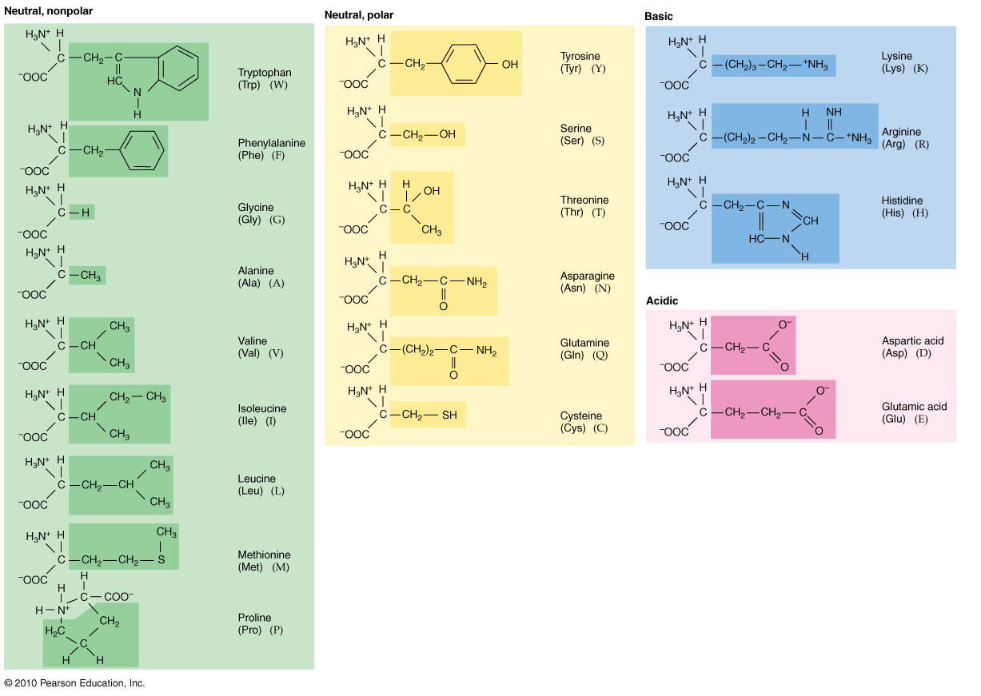

Slide 10
FUNCTIONS:
Enzymes (speed up chem rxns)
Structural (collagen, keratin)
Chemical Messengers (insulin)
Transportation (hemoglobin)
Storage (caesin)
Defense (anti-bodies)

Slide 11
